Slide 1
Start for Life & Family Hub
Offer

Slide 2
Start for Life & Family Hubs DfE funding 2022- March 2025
Is a collaborative and holistic early intervention approach involving multiple departments across the council
The 6 funded key work streams
Infant Feeding
Perinatal Mental Health & Parent-Infant relationships
Home learning Environment & Early Language
Parenting support
Parent Carer Panel
Website
The service is for families from conception to children aged 19 and up to 25 for those with SEND.
Aims:​
Seamless support for families​
A welcoming hub for families​
The information families need when they need it​
An empowered Start for Life workforce​
Continually improving the Start for Life offer​
Leadership for change​​
Notes:
Waltham Forest, Hackney, Newham, Tower Hamlets
The other boroughs that haven’t had funding are still working on developing family hubs

Slide 3
Peep-A-Boo Play and Talk groups - LA
Birth registration
Midwifery
Domestic abuse support
Code:
Yellow DfE Funded
Green Health delivered
Blue LA delivered
Purple mix of delivery partners
Tots ‘n’ Tunes Peep groups
Intensive targeted family support services
Oral health improvement
Activities for 0-5
Health visiting feeding support NEFLT
Home Learning Environment and Early Language
Reducing parental conflict
Peep training
Debt & welfare
Baby Bank
SEND support & services
Infant feeding support
Lifeline & Mind
Heath Visiting
Infant feeding
Housing
Wider Services
Early childhood education & care and financial support
Midwifery infant feeding support
Parent Carer Panel
Youth justice services
Support for separating & separated parents
Start for Life website (moving to Community Hub, including Family Hub shortly)
Perinatal mental health NEFLT
Family Hub Early Help
Youth services
Perinatal mental health and parent-infant relationships
Parent Support
EPEC
Toy library
Mums matter groups - MIND
Marksgate Community Hub and Family Hub
Barking Learning Centre and Family Hub
Dagenham Learning Centre and Family Hub
Family Navigators
Parent programmes
Stop smoking support
Dads in mind groups - MIND
Strengthening Families Strengthening Communities
Mellow Bumps
Triple P online and face to face
Substances (alcohol/drug) misuse support

Slide 4
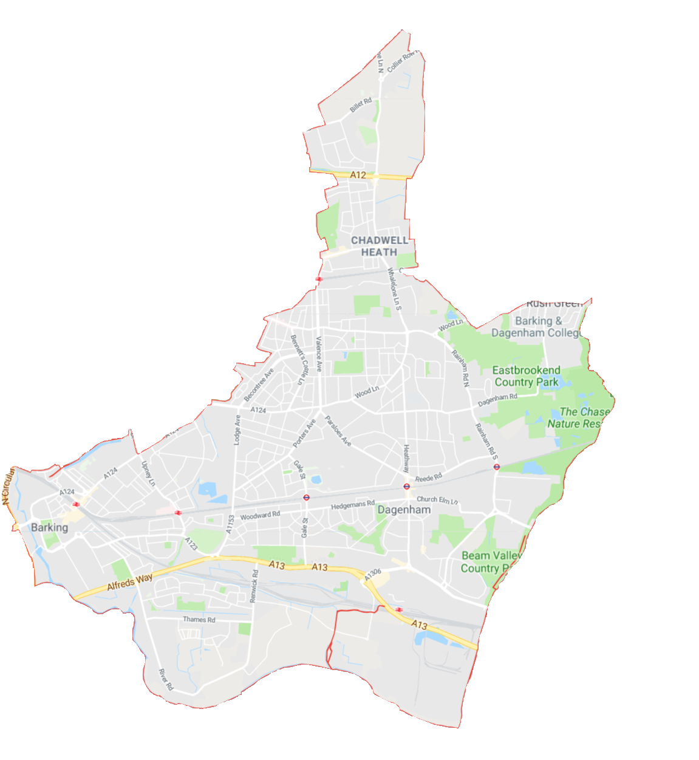
Family Hub Locations
Family Navigators
familynavigators@lbbd.gov.uk
Marks Gate Community and Family Hub
Tanya Ali – Family Navigator
Stacy Collins – Family Navigator
Clare Anena– Family Hub Coordinator
Barking Learning Centre and Family Hub
Claire
Michelle Peters – Family Navigator
Victoria Meribe – Family Navigator
Saira Rana - Family Hub Coordinator
North Locality
Victoria Michelle Saira
Dagenham Learning Centre and Family Hub
NW1
Ashley Morris – Family Navigator
Tamzida Pasha – Family Navigator
Yolanda Wireko – Family Hub Coordinator
East Locality
Notes:
vic
4

Slide 5
Family Navigators Role
Direct work with families, including signposting to relevant services (supporting to navigate through services) up to 4 weeks
Working with schools and partners to support vulnerable pupils to prevent escalation to tier 2B and tier 3 services
Provide support and guidance to our partner agencies i.e. health on thresholds, using the GCP2 and in being lead professionals and completing TAF’S
Deliver training - Solihull, Genogram, Lead Professional & TAF, soon will also be delivering some parenting Programmes
Outreach to partner services – health clinics, hostels
Family Navigators act as a ‘bridge’ between Families and Targeted Early Help Services to support families to access the right service at the right time.
Notes:
I have an example of this That I would like to share
A family was referred to the North Locality Family Navigator service via the TEHAS team to complete a referral to the Tiger Service.
I gained consent from the family and referred the older child to the Tiger service
Through a discussion with the family, it became clear that the younger sibling who had a diagnosis of Autism also needed support. I arranged a TAF meeting with the parent and the OOB school that both children attended to ensure that the school understood the needs of the family and the current circumstances at home.
During this meeting it was agreed that the school would provide interim counselling for the older child and refer the younger child to a mentoring service.
As mother had shared that the younger child would spend a lot of time on his Xbox and was becoming increasingly isolated. I spoke to the YP about some physical activities that were available, initially he appeared reluctant. I arranged to meet him that evening at a boxing class which he agreed to attend.
With mothers consent I contacted the boxing coach and informed them that this YP will be attending that evening. That evening, I attended with the YP and his mother, I introduced him to the coach who immediately engaged the YP in the session, pairing him with a member of staff that has SEN training. Since this session, this YP now attends this service twice a week as well as attending the multi sports half term program.
This is an example of escalation being prevented to tier 2B service due to Early intervention by the FN service.
8

Slide 6
Infant Feeding support sessions
Lifeline & Mind:
A safe and non-judgemental space for you to come and get some feeding support and meet other new parents in the area.
Support through group session, stay and play equipment set up for older children too
Support for breast and bottle feeding
121 sessions also available

Slide 7
Perinatal Mental Health & Parent Infant Relationships
Hnjfnjfnjn
Pregnancy and a new baby can bring a range of emotions. Parental loneliness is a very common feeling, for both parents.
Mums Matter (Mind) for mums feeling overwhelmed, tearful, or anxious, Mums Matter can help you take control of your health and wellbeing, so you can enjoy motherhood to the full
Dads in Mind (Mind) The Dads in Mind project has been developed to aid fathers in the early stages of parenting, focusing on those with a child between 0- 3 years old. The support is inclusive to all dads/fathers, dads with current or previous low to moderate mental health needs, or maybe experiencing some difficulties in their relationships.
Drop in football sessions
Barber shop coming

Slide 8
Parenting programmes
Hnjfnjfnjn
Empowering Parents, Empowering Communities (EPEC) Autism – for children experiencing social communication difficulties or on the pathway for a diagnosis
Triple P Online Baby helps new and expecting parents and carers get off to a positive start
Triple P Online has practical tips for parents and carers with children under 12.
Triple P baby face to face – helps new parents and carers get off to a positive start. For the first year of life
Strengthening Families, Strengthening Communities (SFSC) for parents of children aged 0-18 years.
Mellow Parenting – from 22 weeks of pregnancy until birth

Slide 9
Family Hub Early Help Consortium
1:1 support for families with 2a levels of need that need that little bit more support
The service will provide direct hands on and practical support for families who need a single agency offer of support.
This support will be available in the community and in an environment that is safe and convenient for the family, including their home.
If you have a family who is isolated, struggling with accessing support, need confidence building etc please refer to our service
Criteria
Be pregnant or have a child under 5 years old
Level of support needed is 2a
No current involvement with Early Help or Social Services
Must live in the borough
Must need more than sign positing support
Notes:
Independence and resilience include confidence and own agency to do things.

Slide 10
Peep – speech, language and communication groups
These groups are for all families for 0-5 year olds
Universal groups will support parents to engage in supporting their children’s speech, language and communication
Targeted groups support children with additional needs
There is training that can be provided to staff to learn more about speech, language and communication needs and how you can support children with the needs
The PEEP offer is made up of:
Peep-a-Boo (0-18 months) universal group – 3 a week
Play and Talk (18 months to 4 years) universal group – 8 a week
Play and Talk (18 months to 4yearrs) targeted 6 week group – 6 a half term
Musical Movement (0-4) Started September – 2 groups a week
Notes:
Independence and resilience include confidence and own agency to do things.

Slide 11
Parent Carer Panels
Hnjfnjfnjn
Parent and carer panels set up
Feedback from parent and carer panels is used for continuous improvement of services
Recruit a wide range of parents / carers on the panels.
Parents / Carers empowered to lead the panels.
There will be mechanisms to collect wider parent feedback

Slide 12
Start for Life Website
Hnjfnjfnjn
There will be a virtual place that a family can visit to access information on the advice and support available across the 0-25 age range
We have a website where we are aiming to have all the information / links to the information that parents might need – https://startforlife.lbbd.gov.uk/
Please tell parents you work with about this site.

Slide 13
Added services
Hnjfnjfnjn
The Source Baby Bank at BLC and Dagenham Library
Drop-in support to collect baby related items
12-week access to services to
Oral health service
Support for families to help teeth brushing and registering with a dentist
Free toothbrushes and toothpaste
Free online mediation for parents on low income to support parents who are separating or separated stay out of court
Toy library – being developed for children aged 0-5, focusing on those with SEND
Vitamin Distribution
Breast pump hire via lifeline
Baby Boxes – including baby essentials
GCP2A Pilot
New birth registrations – to engage with families at the earliest point
Online family registration forms
Online referrals screened through EHM
Stay and play groups coming soon

Slide 14
Thank you Any Questions / Comments?

